Slide 1
Notes:
All material in this PowerPoint copyright Metropolitan Opera 2012

Slide 2
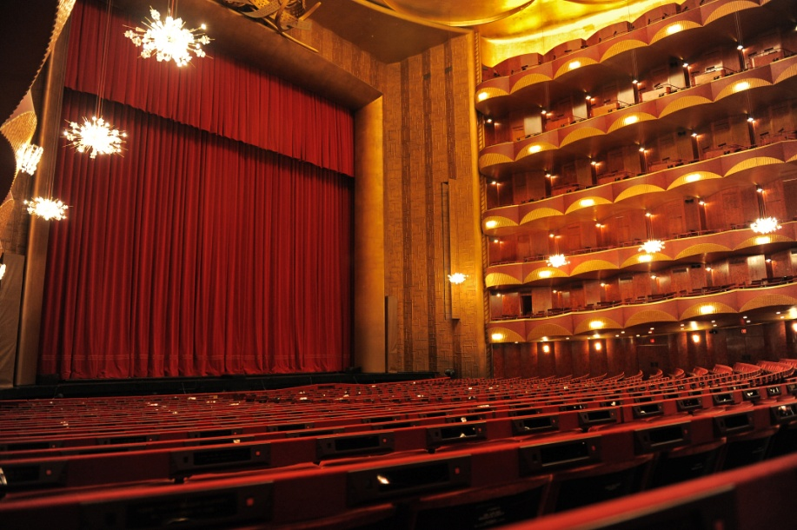
Key Facts
Founded in 1883
Oldest opera company in the United States
Annual Budget: $320,000,000 USD (FY 2012)
Metropolitan Opera House capacity: 3,995 (including standing room)
Tickets range from $20 to $460
1/3 of the ticket prices are less than $100

Slide 3
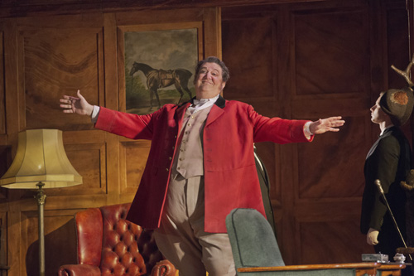
Ambrogio Maestri, Falstaff
2013-14 Season
6 new productions, including 2 Met premieres
20 revivals
Total: 219 main stage opera performances
Radio (live): 19 Saturday International Broadcasts; 95 Satellite Broadcasts
HD: 10 productions; 1 Plazacast (also shown in Times Square)
Additional concerts and events

Slide 4
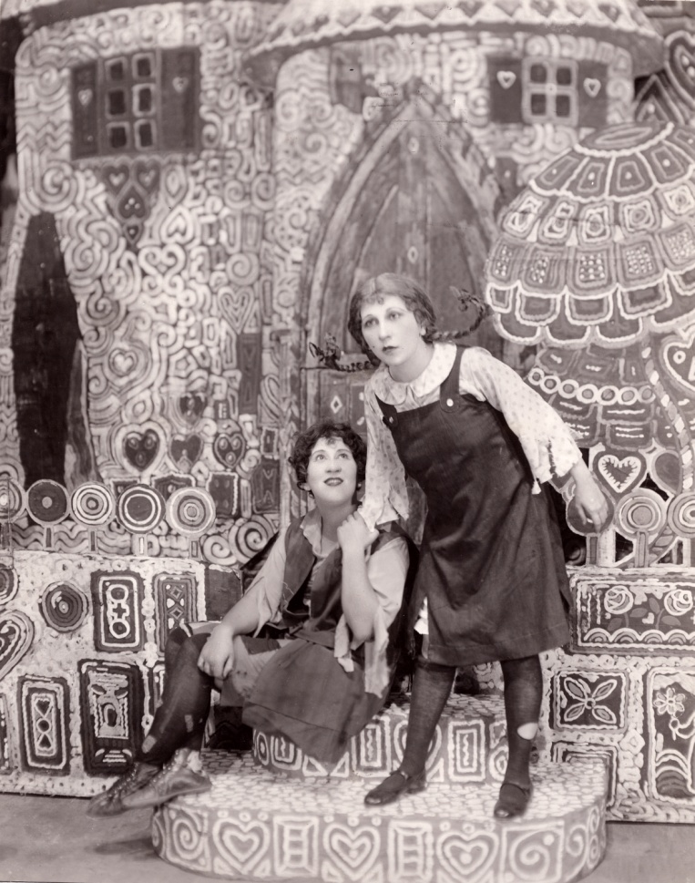
New Technology & Media Initiatives
Saturday Matinee International
Radio Broadcasts
Started December 25, 1931
Beginning 81st season, now heard on the Toll Bros-Met Opera international radio network
America’s longest-running program of its kind
43 countries
8,500,000 annual potential reach
Met Opera Radio on Sirius XM
24/7 commercial-free subscription service
Three weekly live performances and
archival broadcasts
Hänsel und Gretel, 1931

Slide 5
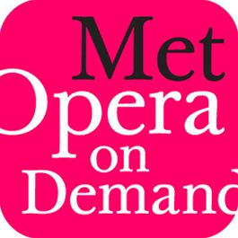
Launched October 2008
Web-based subscription service
More than 477 Met performances
340 radio, 69 standard definition titles, 68 HD titles
Now available through iTunes for the iPad

Slide 6
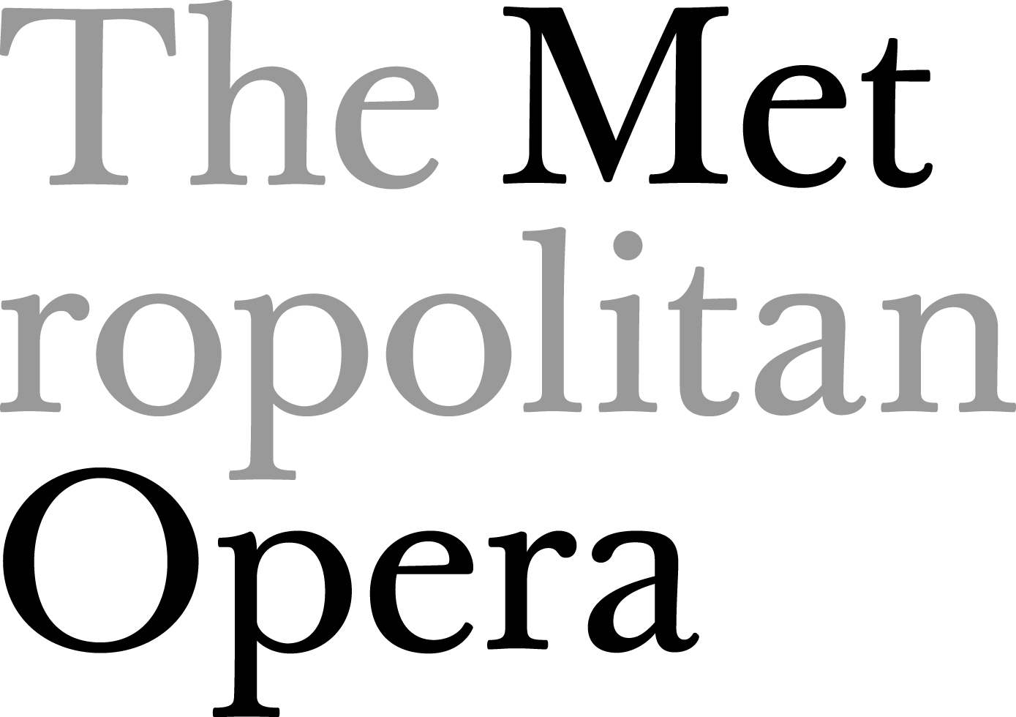
2,000,000+ views
12,000+ subscribers
Over 4,759,000 unique visitors
to website during 2012-13 Season

Slide 7
Social Media @ The Met
269,000+ fans (60% non-U.S.)
87,000+ followers

Slide 8
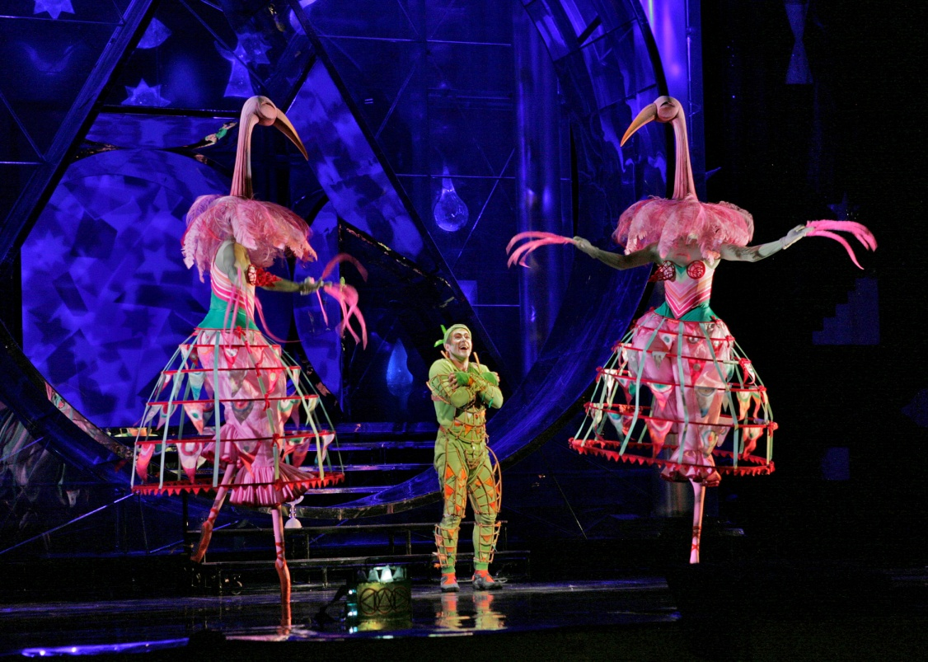
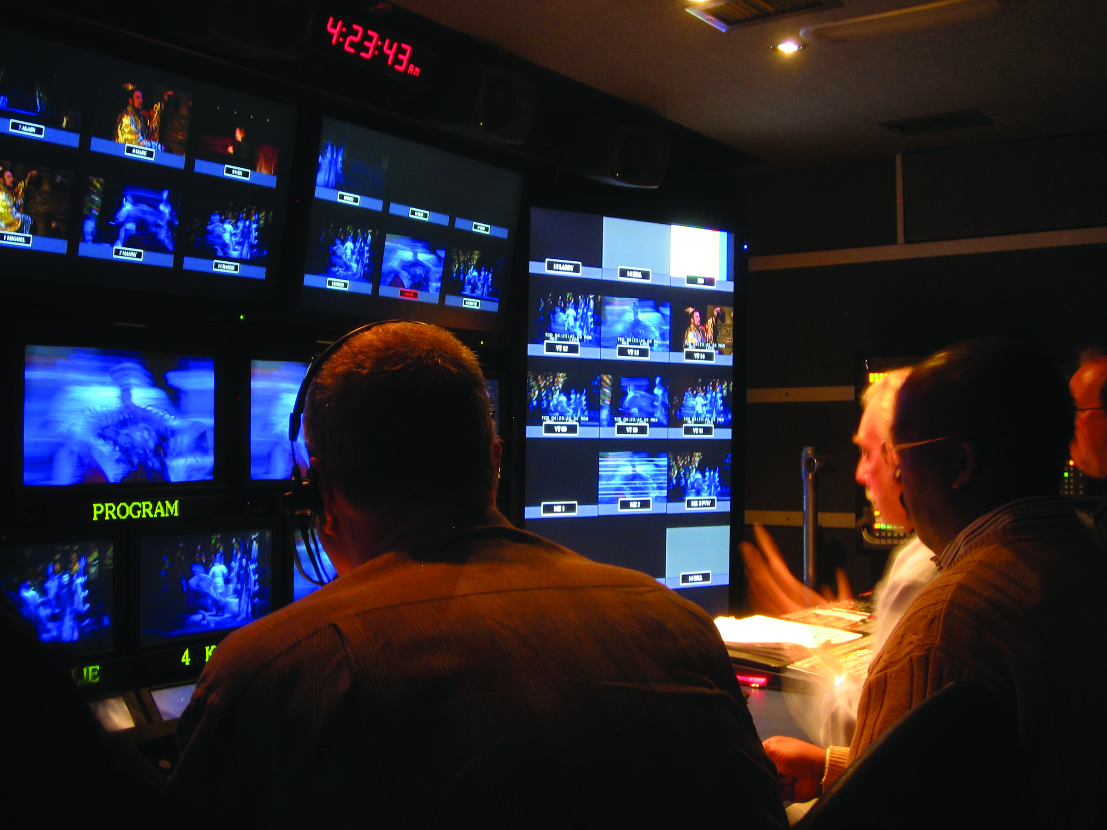
The Magic Flute, 2006
Inside view of remote TV Truck

Slide 9
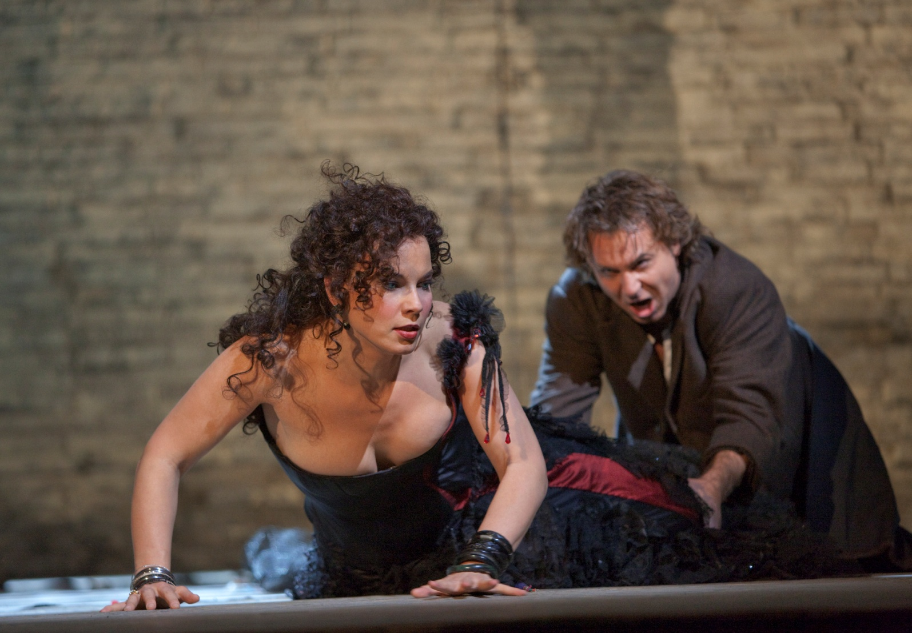
Carmen January 2010
HD Live ticket sales: 240,000

Slide 10
Metropolitan Opera / Live in HD Countries
8
(6 operas)
(8 operas)
(11 operas)
(9 operas)
(12 operas)
(11 operas)
(12 operas)
(10 operas)

Slide 11
Metropolitan Opera / Live in HD Theaters
632
60

Slide 12
Metropolitan Opera / Live in HD Attendance
(6 operas)
(8 operas)
(11 operas)
(9 operas)
(12 operas)
(11 operas)
(12 operas)

Slide 13
14 Million total Live in HD tickets sold to date
Rossini’s The Barber of Seville
2 Emmy Awards: for advancing the technology in the field (2009);
for outstanding technical direction (2010)
Peabody Award (2009): for “reinvent[ing] presentation of a classic art form”
IBC International Honour for Excellence (UK) (2009): for outstanding contribution
Tribeca (Film Festival)’s Disruptive Innovation Award (2011)

